Slide 1
五分鐘看完 C# 7.2
Ouch Liu(劉耀群)

Slide 2





關於我
Ouch Liu (劉耀群)
略懂設計的軟體工程師/ 略懂程式的設計師
軒昂有限公司
Solution Architect
2011~2016 MVP
曾任 TechDays Taiwan 講師 / 微軟客座講師
ouch1978.github.io

Slide 3
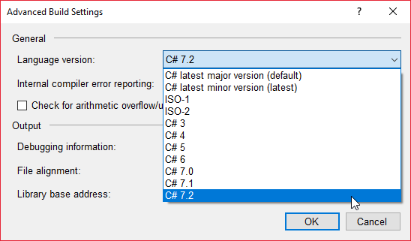
怎樣才能用 C# 7.2 進行開發?
自己的版本自己選!!
Project-> Properties -> Build -> Advanced…

Slide 4
Readonly Ref (in 參數)
防止傳址參數的值被修改(可以直接當作 ref readonly)
static Point Add( in Point point1, in Point point2 )
{
//not OK!!
point1 = default( Point );
//not OK!!
point1.X = 0;
//not OK!!
Foo( ref point1.X );
//OK
return new Point( point1.X +point2.X, point1.Y + point2.Y );
}

Slide 5
Non-Trailing Named Arguments
消滅 CS1738 - Named argument specifications must appear after all fixed arguments have been specified
public void DoSomething( bool isEmployed, string personName, int personAge )
{
//do something
}
void Test()
{
DoSomething( false , "Ouch Liu" , 38 ); //合法
DoSomething( true , personAge: 38 , personName: "Ouch Liu" ); //合法
DoSomething( personAge:38, personName:"Ouch Liu" , isEmployed:false ); //合法
DoSomething( isEmployed:false , “Ouch Liu” , 38 ); //之前會出現 CS1738 錯誤， 7.2之後變合法
DoSomething( true, personName: “Ouch Liu” , 38 ); //之前會出現 CS1738 錯誤，7.2之後變合法
DoSomething( "Ouch Liu" , isEmployed: true, 38 ); //不合法
DoSomething( "Ouch Liu" , 38 , isEmployed: true ); //不合法
}

Slide 6
Leading Separator
7.0
//Binary Literal
private int[] _binaryNumbers = { 0b1 , 0b10 , 0b100 , 0b1000 , 0b100000 , 0b1000000 };
//Digit Separators
private int[] _binaryWithSeparaters = { 0b0000_0001 , 0b0000_0010 , 0b0000_0100 , 0b0000_1000 , 0b0010_0000 , 0b1000_0000 };
7.2
//Binary Literal
private int[] _binaryNumbers = { 0b_1 , 0b_10 , 0b_100 , 0b_1000 , 0b_100000 , 0b_1000000 };
//Digit Separators
private int[] _binaryWithSeparaters = { 0b_0000_0001 , 0b_0000_0010 , 0b_0000_0100 , 0b_0000_1000 , 0b_0010_0000 , 0b_1000_0000 };

Slide 7
Private Protected
C# 修飾詞 | 同組件中 |  |  | 其它組件
 | 同類別 | 衍生類別 | 其它程式碼 | 衍生類別 | 其它程式碼
public |  |  |  |  | 
private |  |  |  |  | 
internal |  |  |  |  | 
protected |  |  |  |  | 
protected internal |  |  |  |  | 
private protected |  |  |  |  | 

Slide 8
參考資料
CSharp-7.2
https://github.com/dotnet/csharplang/tree/master/proposals/csharp-7.2
What's new in C# 7.2
https://docs.microsoft.com/en-us/dotnet/csharp/whats-new/csharp-7-2

Slide 9



Study4.TW
FB聊天社團
Study4.TW
FB粉絲專頁

Slide 10







特別感謝

Slide 11


